Slide 1
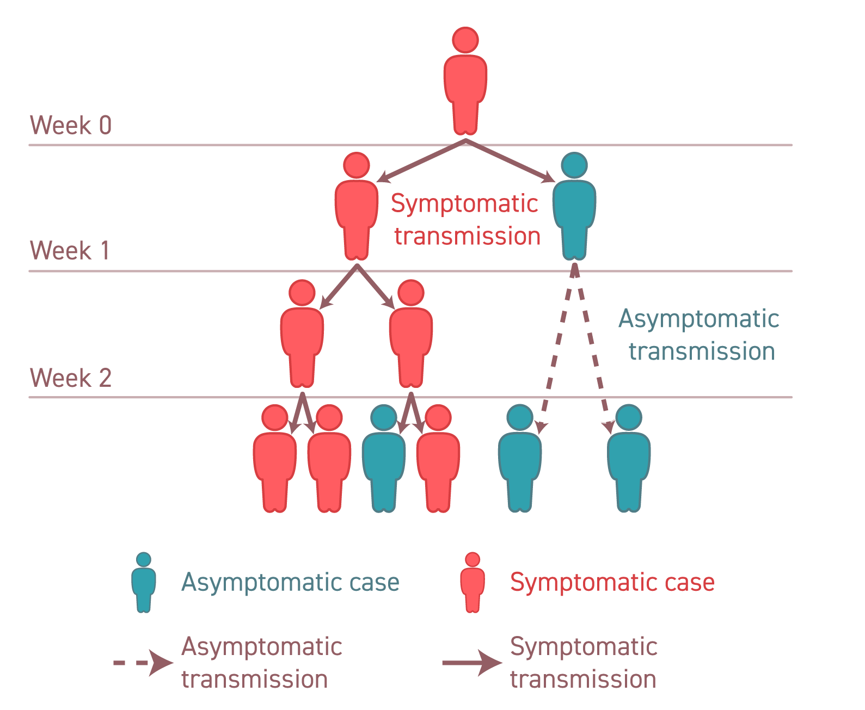




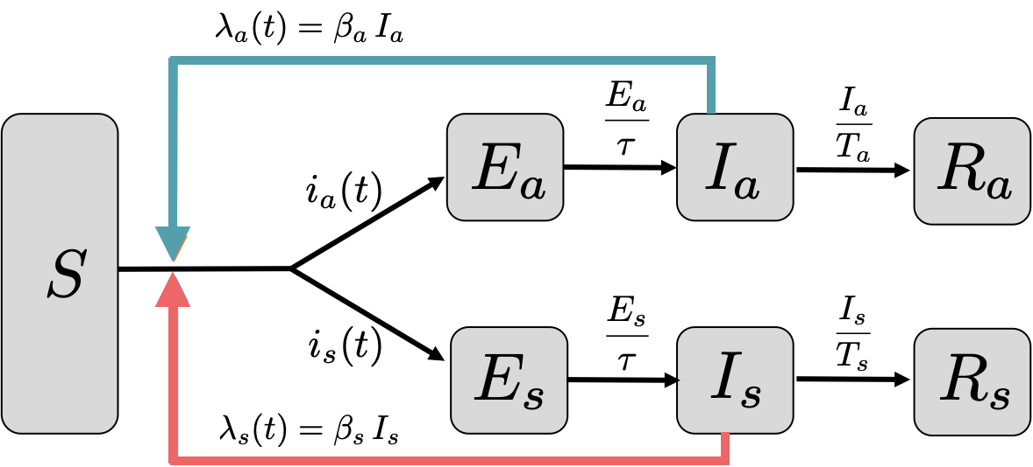


Main finding goes here, translated into plain English. Emphasize the important words.
Individual-level differences in symptomatic and asymptomatic transmission shape population-level dynamics of SARS-CoV-2 outbreaks
Time-scale differences between
asymptomatic vs. symptomatic infections lead to changes in the relevance of
asymptomatic carriers
over the course of an epidemic
Jeremy Harris¹, Sang Woo Park², Jonathan Dushoff^{3,4,5} and Joshua S. Weitz^{1,6}
School of Biological Sciences¹ and School of Physics⁶, Georgia Institute of Technology
Department of Ecology and Evolutionary Biology, Princeton University²
Department of Biology³, Department of Mathematics and Statistics⁴, and M. G. DeGroote Institute for Infectious Disease Research⁵, McMaster University
Model Framework
Project Repository:
https://github.com/Jeremy-D-Harris/Asymptomatic_Transmission_COVID
Background
Symptomatic v.s asymptomatic individuals may have different generation intervals
(e.g., lack of isolation → longer generation intervals)
These time-scale differences can shape outbreak dynamics as well as bias population-level estimates of epidemic strength, speed, and controllability
How do correlations between transmission and disease status impact dynamics?
Approach
Here, we use a series of nonlinear epidemic models to study the impact of differences in time scales between asymptomatic and symptomatic transmission of SARS-CoV-2 on the relative contribution of asymptomatic infections to epidemic dynamics
We build on prior work [1] and show that differences in time scales of transmission may impact estimates of disease severity throughout the course of the epidemic due to changes in the effective proportion of asymptomatic transmission over time.
We do so in two parts.
We study dynamics when transmission outcomes and disease statuses are correlated: that is, transmission from asymptomatic (symptomatic) individuals is more likely to lead to new, asymptomatic (symptomatic) infections.
We examine dynamics given age-dependent assortative mixing coupled with intrinsic differences in symptomaticity with age.
RESULTS
The effective proportion of asymptomatic transmission and realized proportion of asymptomatic incidence increase over time as total incidence decreases
When coupling differences in time scales with age-dependent assortative mixing, we find that the age distribution of infections shifts to younger ages as incidence decreases.
DISCUSSION
These results demonstrate the need to explore the role of time-scale differences in transmission dynamics alongside behavioural changes to explain outbreak features
At early stages of an epidemic, time-scale differences can bias estimates of the basic reproduction number
Throughout an epidemic, time-scale differences can connect shifts in the age of infection to periods of changing incidence
References
Park, S. W., Champredon, D., Weitz, J. S., & Dushoff, J. (2019). A practical generation-interval-based approach to inferring the strength of epidemics from their speed. Epidemics, 27, 12-18.
Figure 1
Figure 2
Parameters:
Variables:
: Susceptible Individuals
: Transmission Rate
: Exposed Individuals
: Exposed Period
: Infected Individuals
: Infectious Period
: Recovered Individuals
: Asymptomatic Individuals
: Symptomatic Individuals
Figure 3
Figure 1. Longer time sales of asymptomatic infections cause increases the proportion of asymptomatic transmission. Setting the infectious period of symptomatic individuals to T_{s} = 5 days, we increase the infectious period of asymptomatic carriers from T_{a} = 5 days (dark blue), T_{a} = 6 days (purple), T_{a} = 8 days (light blue). (A-D) Without intervention the susceptible population is depleted. As new infections decrease, the proportion of asymptomatic transmission increases when the asymptomatic infectious period is longer. (E-H) Changes in the proportion of asymptomatic transmission are comparable with intervention when the reproduction number is reduced to similar levels as with susceptible depletion.
Figure 2. Longer generation intervals coupled with assortative transmission increase the proportion asymptomatic transmission and incidence. Setting the symptomatic infectious period to T_{s} = 5 days, the dashed lines correspond to increasing assortative transmission such that the exponential growth rate and initial proportion of asymptomatic incidence match across simulations. The asymptomatic infectious period is T_{a} = 5 days (dark blue) and T_{a} = 8 days (light blue). For comparison, solid light blue curve is when T_{a} = 8 without assortative transmission (same as in Figure 3). (A-D) With susceptible depletion. (E-H) Changes are comparable with intervention when the reproduction number is reduced to similar levels as with susceptible depletion.
Figure 3. Longer generation intervals of asymptomatic infections coupled with age-dependent assortative mixing and disease factors can decrease the average age of infection. Solid lines indicate baseline contact rates. Dashed lines indicate 4 times (4x) the assortative mixing by age from baseline contacts. We compare when asymptomatic and symptomatic infectious periods equal (T_{a} = T_{s} = 5 days) and when the asymptomatic infectious period is longer (T_{a} = 8 days vs. T_{s} = 5 days).
Funding
*Take a picture to download the preprint
Acknowledgments: Simons Foundation, award number AWD-001014
Notes:
Notes:
In Powerpoint, click View > Guides
Keep text within gutter guides.
Author list: Don’t split names onto two lines (e.g., “Jimmy [break] Smith”). If that happens, use a new line, unless you need the space. Bold the first names of anybody who’s presenting in person.
Intro/methods/result: Do not drop below font size 28, but if you have extra space, jack up the font size until the space is full.
Do not use color in the sidebars except in graphs/figures. It’ll pull attention from the center and slow interpretation for passersby.

